Slide 1
Lecture - 18 Discrete Time Signal and Systems

Slide 2
Module 1:
Signals
Sampling
Systems
Periodic Signals
Discrete-Time Sinusoidal Signals
Real Exponential Signals
Complex Exponential Signals
The Unit Impulse
Simple Manipulations of Discrete-Time Signals
Problems

Slide 3
Signals and Systems
1.0 Introduction
The terms signals and systems are given various interpretations. For example, a system is an electric network consisting of resistors, capacitors, inductors and energy sources.
Signals are various voltages and currents in the network. The signals are thus functions of time and they are related by a set of equations.

Slide 4
Example:
i(t)
R
+
-
C
+
i(t)
v_{C}(t)
-
Figure: 1.0: An electric circuit
The objective here is to determine the behaviour of the system for a specific input or excitation

Slide 5
It is often convenient to represent a system schematically by means of a box as shown in Figure 1.1.
System Output
Input
Figure: 1.1: General representation of a system.

Slide 6
1.1 Signals
There are two types of signals:
Continuous – time signals
Discrete – time signals
In the case of a continuous-time signal, x(t), the independent variable t is continuous and thus x(t) is defined for all t (see Fig 1.2).
t – Continuous time -independent variable (-∞ < t < ∞)

Slide 7
On the other hand, discrete-time signals are defined only at discrete times and consequently the independent variable takes on only a discrete set of values (see Figure 1.2).
A discrete- time signal is thus a sequence of numbers.
n – discrete time - independent variable
( n = … -2, -1, 0, 1, 2,…)

Slide 8
Examples:
A person’s body temperature is a continuous-time signal.
The prices of stocks printed in the daily newspapers are discrete-time signals.
Voltages & currents are usually represented by continuous-time signals. They are represented also by discrete-time signals if they are specified only at a discrete set of values of t.

Slide 9
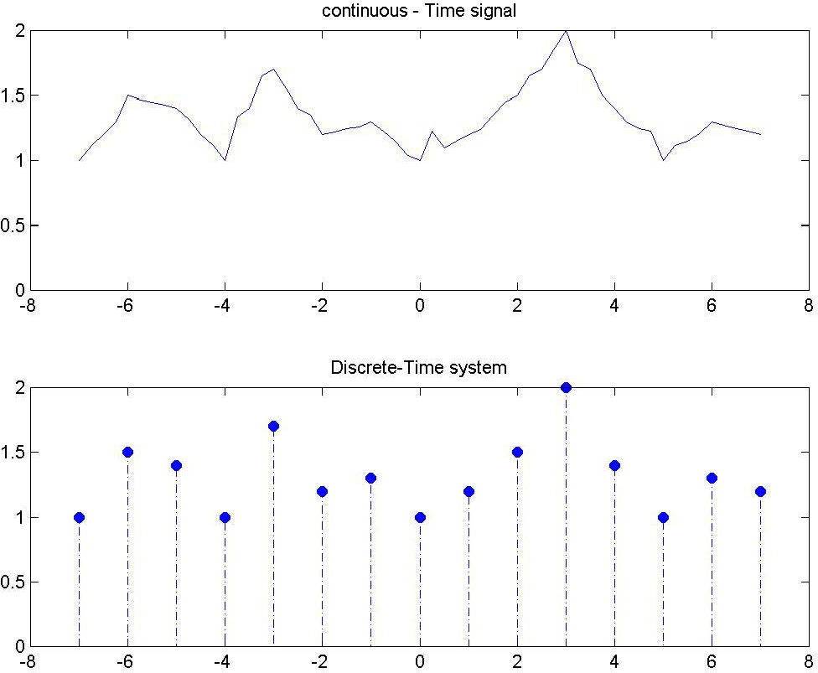
Figure 1.2: Above: An example of continuous-time signals. Below: An example of discrete-time signals.

Slide 10
Sampling
A discrete-time signal is often formed by sampling a continuous -time signal x(t). If the samples are equidistant then
x[n]= x(t )
t =nT
= x(nT )
(1.1)
Square brackets [ ] ⇒ Discrete time signals Round Brackets ( ) ⇒ Continuous signals

Slide 11

x(nT) = x[n]
Analogue Signal x(t)
Digital signal
f = ¹
s
T
The constant T is the sampling interval or period and
the sampling frequency f = ¹ Hz.
s
T

Slide 12













Figure 1.4: An example of acquiring discrete-time signals by sampling continuous-time signals.
x[n] = { 3.5, 4, 3.25, 2, 2.5, 3.0 }
n=-1 n=0 n=2 n=4

Slide 13
It is important to recognize that x[n] is only defined for integer values of n. It is not correct to think of x[n] as being zero for n not an integer, say n=1.5. x[n] is simply undefined for non-integer values of n.

Slide 14
Sampling Theorem:
If the highest frequency contained in an analogue signal x(t) is f_{max} and the signal is
sampled at a rate f_{s} ≥ 2 f_{max} then x(t) can be exactly recovered from its sample values using an interpolation function.

Slide 15
Example:
Audio CDs use a sampling rate, f_{s}, of 44.1 kHz for storage of the digital audio signal. This sampling frequency is slightly more than 2×f_{max} [f_{max} = 20kHz], which is generally accepted upper limit of human hearing and perception of music sounds.

Slide 16
Example: continuous-time unit step function u(t)
t ≥ 0
⎩0 t < 0
u(t) = ^{⎧1}
(1.2)
⎨
It is defined by [Fig 1.5].

Slide 17
Its discrete-time signal is discontinuous at t = 0.
Its samples u[n] = u(t)|_{t=nT} form the discrete-time signal and defined by
n ≥ 0
⎩0 n < 0
u[n] = ^{⎧1}
(1.3)
⎨

Slide 18
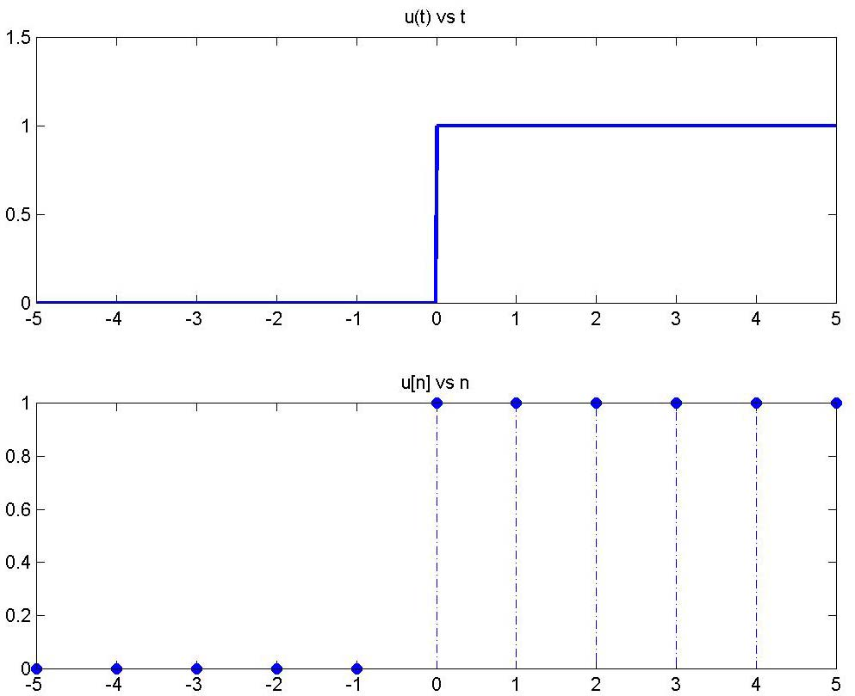
Figure 1.5: Top: Continuous-time unit step function. Bottom: Discrete-time unit step function.

Slide 19
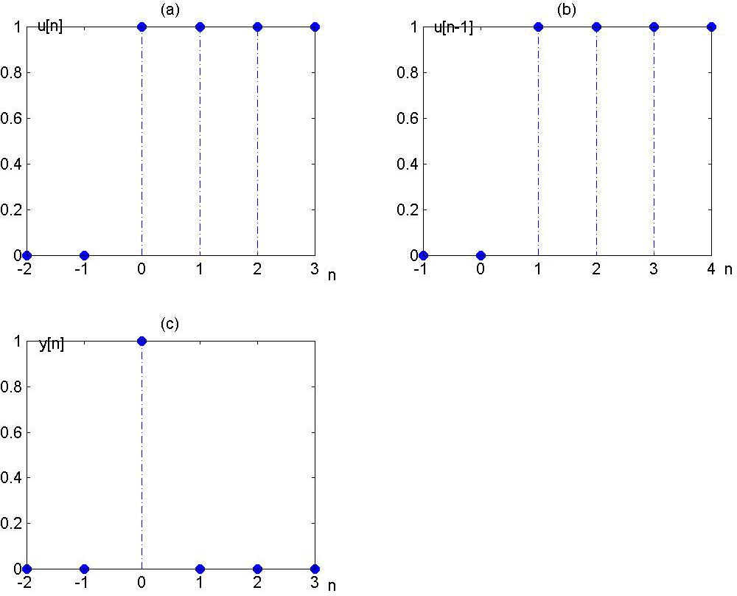
Exercise:
Sketch the wave form: y[n] = u[n]− u[n − 1]

Slide 20
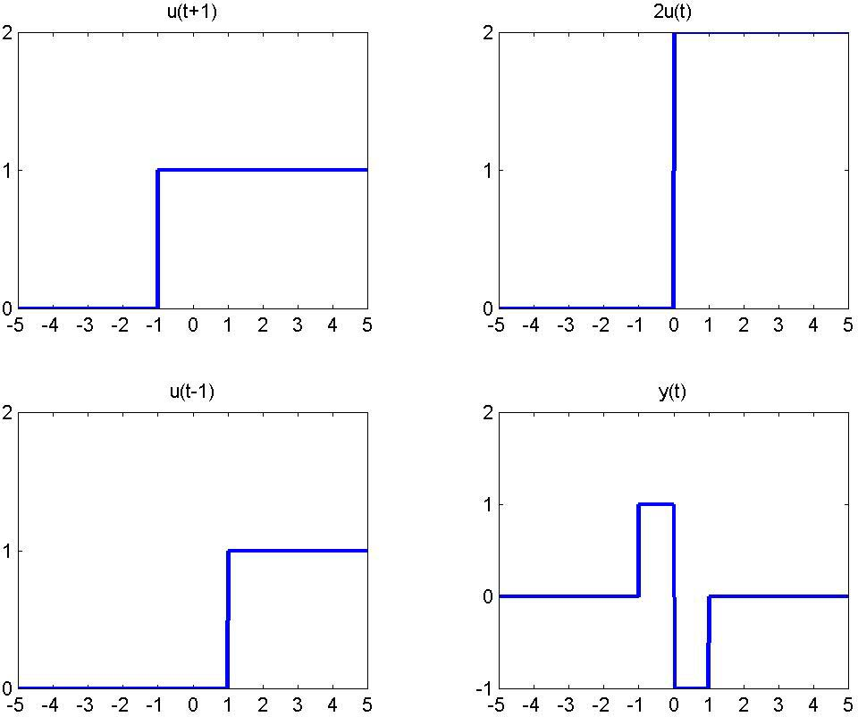
Exercise:
y(t ) = u(t + 1) − 2u(t ) + u(t − 1)
Sketch the waveform for

Slide 21
1.3 Systems
A continuous-time system is one whose input x(t) and output y(t) are continuous time functions related by a rule as shown in Fig 1.6(a).
y(t)
x(t)
x(t)
Continuous
Time System
y(t)
t
t
Fig 1.6 (a): General representation of continuous-time systems.

Slide 22
A discrete system is one whose input x[n] and output y[n] are discrete time function related by a rule as shown in Fig 1.6(b).
x[n]
Discrete Time System
y[n]
x[n]
y[n]
n
n
Fig 1.6 (b): General representation of discrete-time systems.

Slide 23
An important mathematical distinction between continuous-time and discrete-time systems is the fact that the former are characterized by differential equations whereas the latter are characterized by difference equations.

Slide 24
Example:
The RC circuit shown in Figure 1.7 is a continuous-time system
output
i(t)
R
e(t) input
+
v_{C}(t)
+
C
-
i(t)
-
Figure 1.7: A diagram of RC circuit as an example of continuous-time systems.

Slide 25
output
i(t)
R
e(t) input
+
v_{C}(t)
+
C
-
i(t)
-
If we regard e(t) as the input signal and v_{c}(t) as the output signal, we obtain using simple circuit analysis
dv_{C} (t) ₊
dt
¹ v (t) = ¹ e(t) (1.4)
C
RC RC

Slide 26
dv_{C} (t) ₊
dt RC RC
¹ v (t) = ¹ e(t)
(1.4)
C
From equation (1.4), a discrete -time system can be developed as follows: If the sampling period T is sufficiently small,
dv_{C} (t)
dt
₌ v_{C} (nT ) − v_{C} (nT − T )
T
(1.5)
t =nT

Slide 27
v_{C}(t)
v_{C}(nT)
P
v_{C}(nT)-v_{C}(nT-T)
T
nT-T nT
Backward Euler approximation [Assuming T is sufficiently small]
t
Figure 1.8: An approximation of discrete-time systems from the continuous-time systems.

Slide 28
v_{C} (nT )− v_{C} (nT − T ) ₊ 1
By substituting equation (1.5) into (1.4) and replacing t by nT, we obtain:
1
RC
v (nT ) =
e(nT )
T
RC
C
The difference equation is:
v_{C}[n] − v_{C}[n −1] ₊
¹ v [n] = ¹ e[n]
T
C
RC RC
T
difference equation
v [n] =
^{RC} v [n−1]+
e[n] (1.6)
C
RC+T
C
RC+T
output
previous output
input

Slide 29
Summary:
Continuous-Time System
Differential Equations
Analogue input
Analogue output
Difference Equations
Digital input
Digital output
Discrete-Time System

Slide 30
Example:
Analogue Signal
Discrete-time signal
x[n] = e^{anT}
1.
x(t) = e^{at}
t=nT
time
sampling frequency
f = ¹ Hz
Sample number [0,1,2,3,…]
Sampling Period (T)
s
T
2. x(t) = 10e^{-t} – 5e^{- 0.5 t}
x[n] = 10e^{-nT} – 5e^{- 0.5 nT}
t=nT
sample number

Slide 31
3. x(t) = Acos(ω_{a}t)
x[n] = A cos(ω_{a}nT)
t=nT
Analogue frequency
in radians ω_{a} = 2πf_{a}
= A cos(2πf ⋅ n ⋅ ¹ )
a
f
s
= A cos(2π ^{fa} ⋅ n) = A cos(nθ )
f_{s}
θ = digital frequency
θ = 2π ^{fa}
f_{s}
θ=ω_{a}T
Exercise :
x(t) = A(1+m cos(ω_{m}t))cos(ω_{c}t)
x[n] =?

Slide 32
1.4 Periodic Signals
An important class of signals is the periodic signals. A periodic continuous-time signal x(t) has the property that there is a positive value
of P for which
x(t ) = x(t + P)
(1.7)
for all values of t.
In other words, a periodic signal has the property that is unchanged by a time shift of
P. In this case we say x(t) is periodic with period P.

Slide 33
Example :
x(t)
period = P
-P 0
P 2P
t
Figure 1.9A: An example of periodic signals
Periodic signals are defined analogously in discrete time. A discrete-time signal x[n] is periodic with period N, where N is a positive integer, if for all
values of n.
x[n]= x[n + N ]
(1.8)

Slide 34
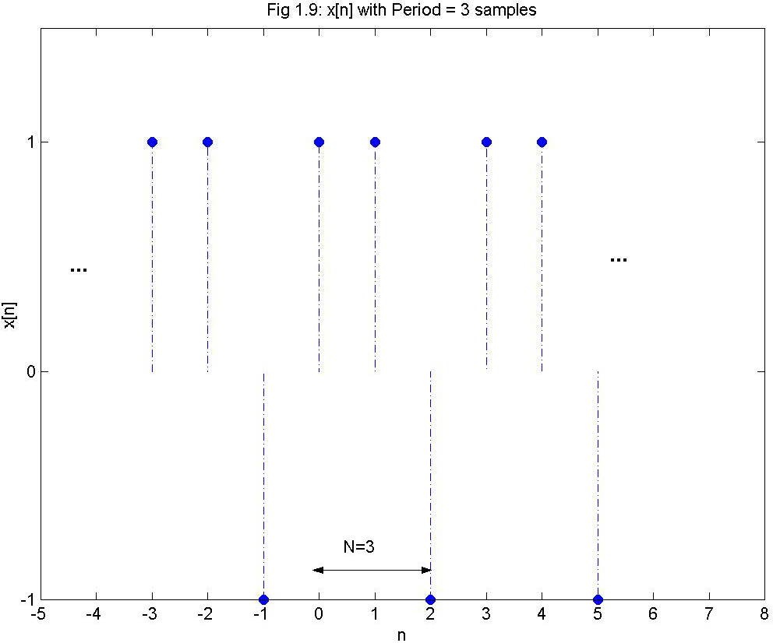
Example :

Slide 35
1.5 Discrete-Time Sinusoidal Signals
A continuous-time sinusoidal signal is given by
x(t ) = Asin(ω_{a}t ) = Asin(2πf_{a}t )
(1.9)
f_{a} = analogue frequency
A discrete - time sinusoidal signal may be expressed as
x[n] = x(t)|_{t=nT} = x(nT)
x[n] = Asin(nω T ) = Asin(2π ^{fa} n)
(1.10)
a
f
s
x[n] = Asin(nθ )
Sampling frequency f = ¹
s
T
f
θ - Digital frequency
θ = 2π
a
= ω T (1.11)
f
a
s

Slide 36
x[n + N ]= x[n]
A discrete-time signal is said to be periodic with a period length N, if N is the smallest integer for which
Asin((n + N )θ ) = Asin(nθ )
which can only be satisfied for all n if Nθ=2πk
(where k is an arbitrary integer)
_{N =} 2πk ₌ 2πk
θ
2π ^{fa}
f_{s}
see equation (1.11)

Slide 37
N = ^{fs} k
f_{a}
(1.12)
So if f = 1000Hz & f = 8000 Hz then N = ⁸⁰⁰⁰ = 8 samples
a s
1000
An example of a sinusoidal sequence is shown in Fig 1.10.

Slide 38
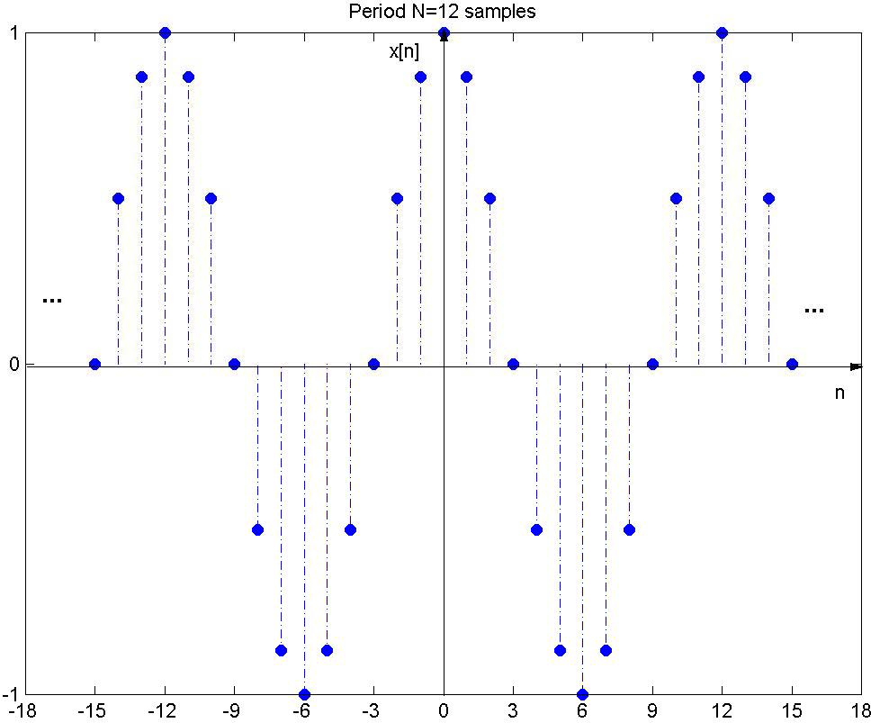
Figure 1.10: An example of sinusoidal sequences. The
⎛ 2πn ⎞
period, N, is 12 samples. x[n] =
cos⎜ ₁₂ ⎟
⎝ ⎠

Slide 39
Example:
Determine the fundamental period of x[n],
x [n] = 10 cos ^{⎛ 2π} n + ^{π ⎞}
₅ ⎟
⎜ 15
⎝ ⎠
digital frequency θ = ^{2π}
15
The fundamental period is therefore (see equation (1.12))
_{N =} 2πk
θ
where k is the smallest integer for which N has an
integer value. This is satisfied when k = 1.
N = ^{2π ⋅1} = 15 samples
2π
15

Slide 40
Example:
The sinusoidal signal x[n] has fundamental period N=10 samples. Determine the smallest θ for which x[n] is periodic:
_{θ =} 2πk ₌ 2π _{k}
N 10
Smallest value of θ is obtained when k = 1
∴ θ = ^{2π} = ^{π} radians / cycle
10 5

Slide 41
1.6 Real Exponential Signals
where c and a are, in general complex numbers. Depending upon the values of these parameters, the complex exponential can exhibit several different characteristics.
The continuous-time complex exponential signal is of the form
x(t ) = ce^{at}
(1.13)

Slide 42
x(t)
Growing exponential a>0.
c
t
x(t)
Decaying exponential a<0
c
t
Figure 1.11: Characteristics of real exponential signals in terms of time, t. Top: For a>0, the signal grows exponentially. Bottom: For a<0, the signal decays exponentially.

Slide 43
1.7 Complex Exponential Signal [8]
Consider a complex exponential, ce^{at} where c is expressed in polar form, c = c e ^{jθ} , and a in rectangular form, a = r + jω₀ .
Then
_{ce}at _{=| c | e} jθ _{e}( r + jω₀ )t _{=| c | e}rt _{⋅ e} j (ω₀t +θ )
rt
ω t + θ ) + j | c | e sin(
ω t + θ )
=| c | e cos(
rt
(1.14)
0 0
Thus, for r = 0, the real & imaginary parts of a complex exponential are sinusoidal.

Slide 44
For r > 0 ⇒ Sinusoidal signals multiplied by a growing exponential
For r < 0 ⇒ Sinusoidal signals multiplied by a decaying exponential [≅ damped sinusoids]
x(t)
r>0
x(t)
r<0
t
t
Growing sinusoidal signal
Decaying sinusoidal signal
Figure 1.12: Characteristics of complex exponential signals.

Slide 45
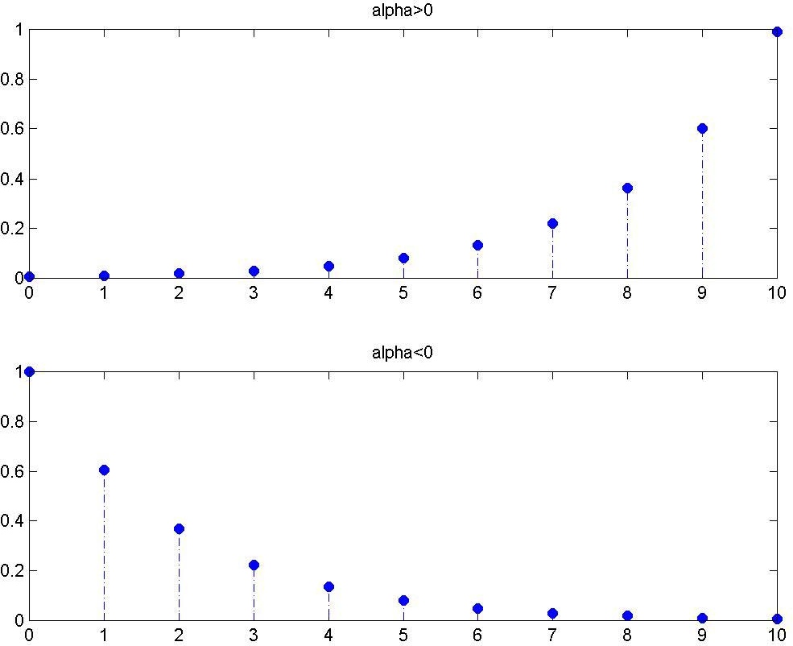
In discrete time, it is common practice to write a real
exponential signal as
x[n] = cα^{n}
(1.15)
If c and α are real and if |α|>1 the magnitude of the signal grows exponentially with n, while if |α|<1 we have decaying exponential.

Slide 46

Figure 1.13: Examples of discrete-time exponential signals.

Slide 47
1.8 The Unit Impulse
An important concept in the theory of linear systems is the continuous time unit impulse function. This function, known also as the Dirac delta function is denoted by δ(t) and is represented graphically by a vertical arrow.
δ(t)
Magnitude
1
1
0 t
Frequency
Figure 1.14: Characteristic of the continuous-time impulse function and the corresponding magnitude response in the frequency domain.

Slide 48
The impulse function δ(t) is a signal of unit area vanishing everywhere except at the origin.
∞
∫ δ ( t ) dt = 1 , δ ( t ) = 0
− ∞
for t ≠ 0 (1.16)
The impulse function δ(t) is the derivative of the step function u(t).
_{δ (t) =} du(t)
(1.17)
dt
u(t)
_{δ (t) =} du(t)
dt
1
1
t
t

Slide 49
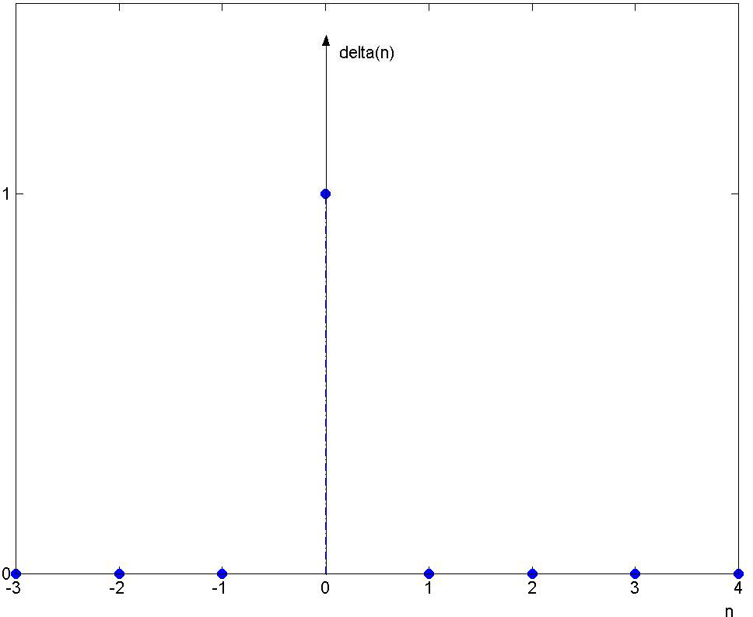
The discrete-time unit impulse function δ[n] is defined in a manner similar to its continuous time counterpart. We also refer δ[n] as the unit sample.
n = 0
⎩0 n ≠ 0
δ [n] = ^{⎧1}
(1.18)
⎨
Figure 1.15: Characteristic of discrete-time impulse function.

Slide 50
1.9 Simple Manipulations of Discrete- Time Signals
A signal x[n] may be shifted in time by replacing the independent variable n by n-k where k is an integer.
If k>0 ⇒ the time shift results in a delay of the signal by k samples [ie. shifting a signal to the right]
If k<0 ⇒ the time shift results in an
advance of the signal by k samples.

Slide 51
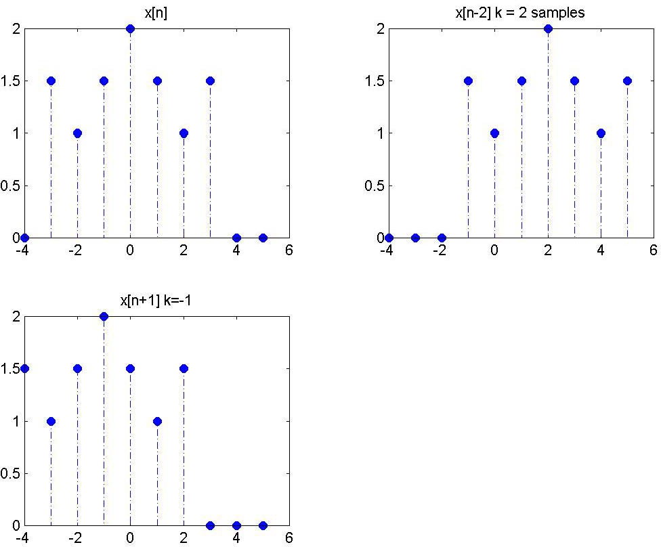
Figure 1.16: Top left: Original signal, x[n]. Top right: x[n] is delayed by 2 samples. Bottom left: x[n] is advanced by 1 sample.
Advance: Shifting the signal to the left Delay: Shifting the signal to the right

Slide 52
HOMW-WORK

Slide 53
Problems:
Q1. A discrete – time signal x[n] is defined by
0 ≤ n ≤ 9
⎩0 otherwise
x[n] = ^{⎧1}
⎨
Using u[n], describe x[n] as the
superposition of two step functions.

Slide 54
Q2. Sketch the following:
(a) x(t) = u(t-3) – u(t-5)
(b) y[n] = u[n+3] – u[n-10]
x(t) = e^{2t}u(-t)
y[n] = u[-n]
(e) x[n] = δ[n] + 2δ[n-1] -δ[n-3] (f) h[n] = 2δ[n+1] + 2δ[n-1]
(g) h[n] = u[n], p[n] = h[-n]; q[n] = h[-1-n], r[n] = h[1-n] (h) x[n] = α^{n}, α<1
P[n] = α^{n} u[n], q[n] = α^{n}u[-n]
(i) x(t) = e^{-3t}[u(t) – u(t-2)]

Slide 55
x[n] = cos⎡⎢n ^{π} + ^{π}
Q3. a) Consider a discrete-time sequence
⎣
Determine the fundamental period of x[n].
(b) i) Consider the sinusoidal signal
x(t) = 10 sin(ωt) ω=2πf_{a}
f_{a} -analogue frequency and t- time,
f_{s} -sampling frequency
Write an equation for the discrete time signal x[n]
ii) If f_{a} = 200 Hz and f_{s} = 8000 Hz, determine the fundamental period of x[n].
8 5 ⎦

Slide 56
Summary :
It is expected that you should know:
The difference between signals and systems
The sampling theorem, its limitations (e.g. aliasing), and the sampling frequency (f_{s})
How to distinguish between continuous (analog) and discrete time (digital) signals
How to distinguish between differential and difference equations

Slide 57
Continuous and discrete periodic signals and their definitions
The relationship between analog and digital
frequency θ = ^{2π fa}
f _{s}
The number of samples in a period: N = ^{2π k} = ^{f sk}
θ
f_{a}
θ = Digital frequency
Manipulation of discrete-time signals
The unit impulse and its properties

